Slide 1
MOSFET: Metal-Oxide-Semiconductor Field-Effect Transistor

Slide 2
Types of MOSFETs
• Enhancement Mode: OFF at V_GS = 0, ON if V_GS > V_th
• Depletion Mode: ON at V_GS = 0, OFF with negative V_GS
• NMOS: N-channel, uses electrons
• PMOS: P-channel, uses holes
• Differ in threshold voltage and conduction
• Common in complementary CMOS design

Slide 3
MOSFET refers to a Metal-Oxide-Semiconductor Field-Effect Transistor operating in a region where it can amplify or control electrical signals. Unlike passive devices (resistors, capacitors, inductors) which only transform energy, active devices like MOSFETs can control current flow based on an applied electrical signal, essentially adding energy to a signal (gain).

Slide 4
Structure of N-Channel MOSFET
• Gate: Metal or polysilicon over SiO₂
• Source/Drain: N+ doped regions
• Body: P-type silicon substrate
• Channel forms under gate with V_GS > V_th
• Insulated gate allows voltage control
• Diagram included: MOSFET layout

Slide 5
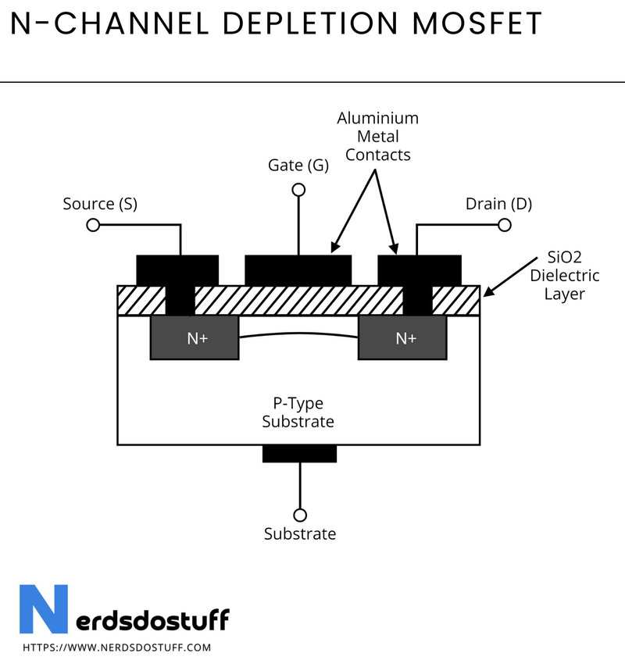

Slide 6
Working Principle - OFF and ON States
• OFF State: V_GS < V_th → No channel formed
• Only leakage current flows
• ON State: V_GS > V_th → Inversion layer forms
• Electrons flow from Source to Drain
• Gate voltage repels holes in substrate
• Enables current conduction

Slide 7
Modes of Operation
• Cutoff: V_GS < V_th → No conduction
• Triode: V_DS < (V_GS - V_th) → Resistive behavior
• Saturation: V_DS ≥ (V_GS - V_th)
• Current saturates, good for amplification
• Transitions depend on gate and drain voltages
• Important for analog and digital switching

Slide 8
Applications in Digital Electronics
• Core of CMOS logic gates
• Used in microprocessors and memory (DRAM, Flash)
• Very low static power consumption
• Form the basis of modern ICs
• Enable miniaturization in computing devices
• Essential for smartphones and computers

Slide 9
Power Electronics Applications
• Used in switching regulators and converters
• High-efficiency motor drivers
• Power management in electric vehicles
• Key in solar inverters and UPS systems
• Enables fast switching and high current handling
• Power control with minimal losses

Slide 10
RF, Automotive, and Industrial Use
• Found in RF amplifiers and transceivers
• Used in mixers for frequency conversion
• Power control in electric vehicles
• Automation and robotics systems
• Withstand high voltage and current loads
• Key role in wireless and industrial tech

Slide 11
THANK YOU

